Slide 1
A Study of Simulation of Sensor Calibration for Mounting Inspection of ADAS Camera and LiDAR
Yeham Kim, Yeeun Lee
Prof. Youngkeun Kim
Notes:
The title of our study is Simulation of Sensor Calibration for Mounting Inspection of ADAS Camera and LiDAR
I’m a presenter YeHam Kim.

Slide 2
CONTENTS
Introduction
Process
Simulation Result
Experiment Result
Conclusion
Notes:
I’m going to make the presentation in this order.

Slide 3
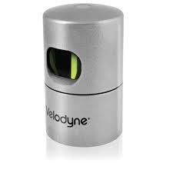
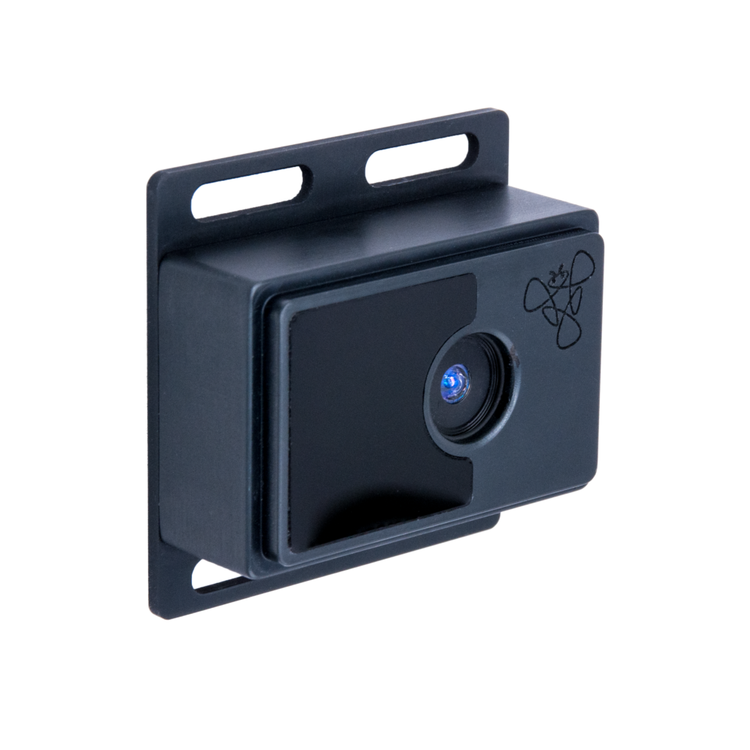
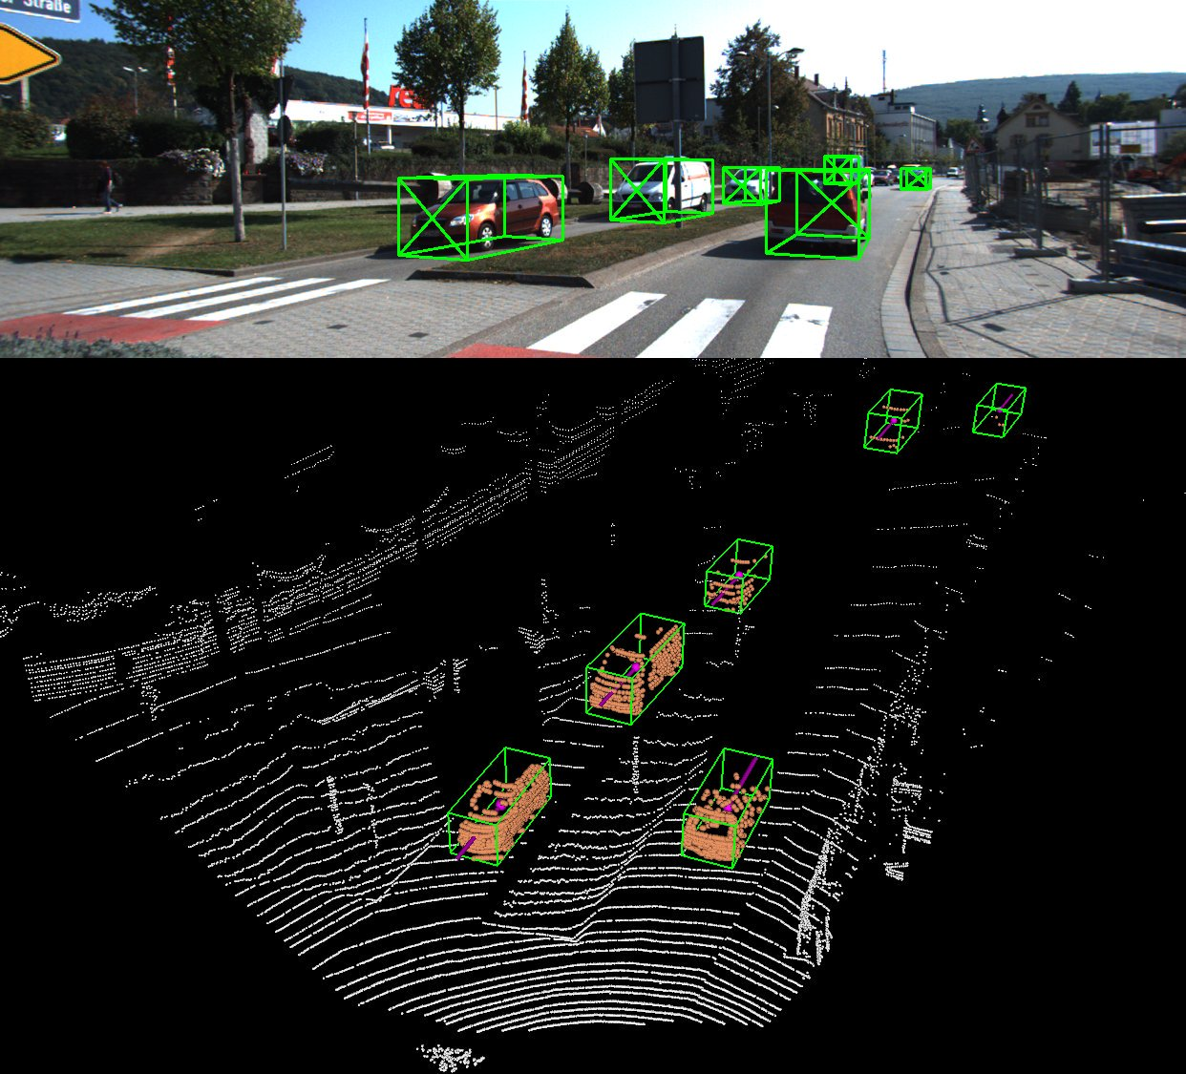
I. Introduction
Research Background
LiDAR and camera are used as ADAS sensors for smart vehicle.
LiDAR and camera sensor data can be fused to recognize and detect driving environment.
To use LiDAR and camera sensor together, calibration between the two sensors must be processed accurately.
LiDAR
Camera
Research Objectives
Develop a calibration system for LiDAR and camera
Design calibration algorithm using a cube-type target object
Validation of the algorithm through simulation and experiment.
Sensor Fusion Image
Notes:
Introduction, our research background and objectives are as follow.
LiDAR and camera are used as ADAS sensors for smart vehicle.
Because their data can be fused to recognize and detect driving environment.
Therefore, the calibration between the two sensors must be accurate.
-----------------------------------------------------------
In this study, we developed a calibration system and algorithm using cube target.
And we verified our algorithm through simulation and experiment.

Slide 4
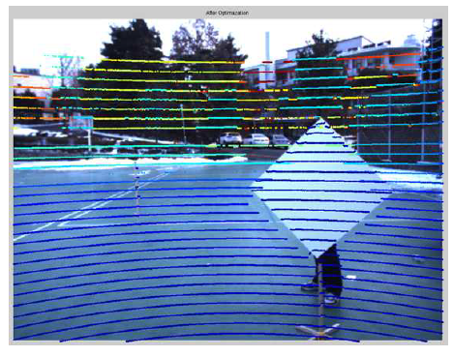
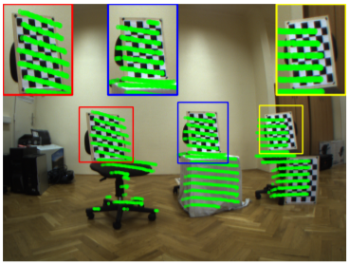
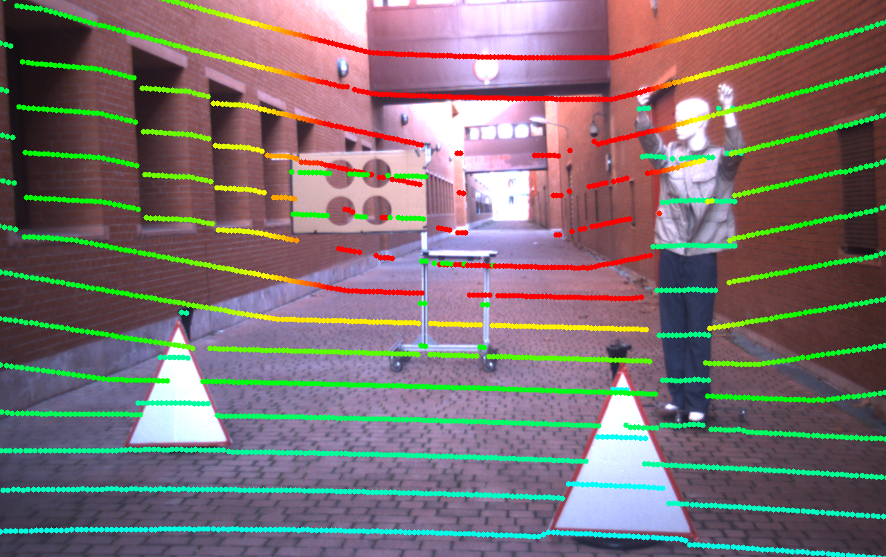
I. Introduction
Existing Method
Generally, planar target is used for calibration between LiDAR and camera.
Using planar target for calibration is based on edge detection.
Finding feature points on planar target is easy with existing edge detection method.
To obtain accurate calibration result, the use of the high-resolution LiDAR is necessary.
Diamond Plane
Check Board
Various Targets
Notes:
Generally, planer target is used for calibration between LiDAR and camera as shown in these figures.
Using planar target for calibration is based on edge detection.
The advantage of this algorithm is easy to find feature points.
However, to obtain accurate result, it is necessary for using the high-resolution LiDAR

Slide 5
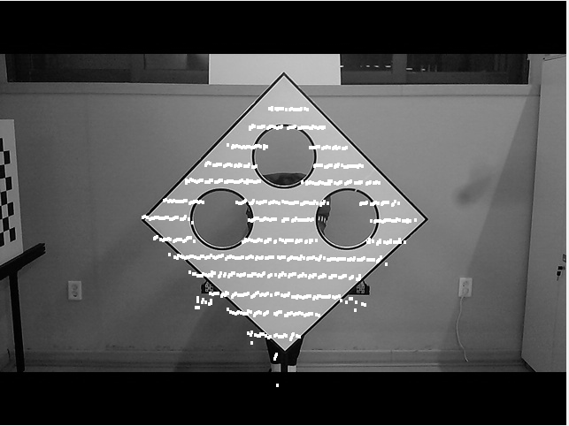
I. Introduction
Proposed Method
Instead of planar target, 3D cube was used as a calibration target in this study.
Using cube target for calibration is based on three sides and perpendicular characteristic.
The cube target has more feature points than planar target.
This proposed method is less affected by the LiDAR resolution.
Previous Study for Calibration
Proposed Method
Notes:
So In this study, we used 3D cube as a calibration target.
Because the cube target has more feature points than planar target. Three sides, perpendicular characteristic.
Therefore, this proposed method is less affected by the LiDAR resolution.

Slide 6
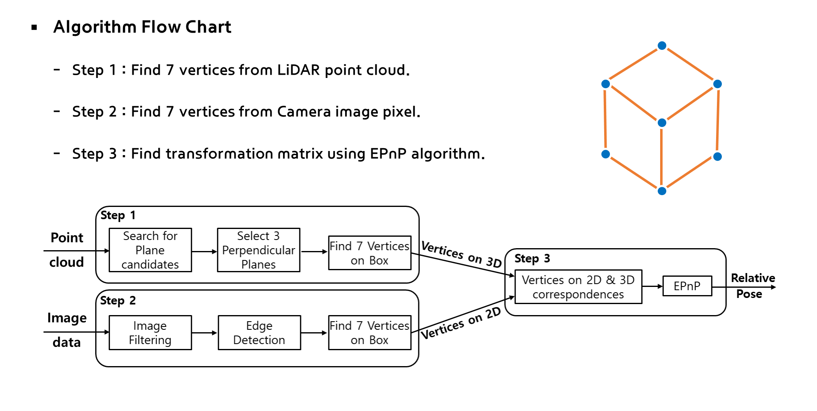
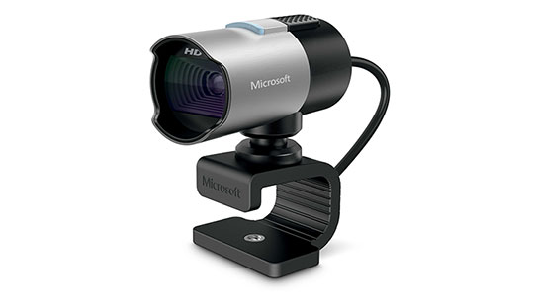
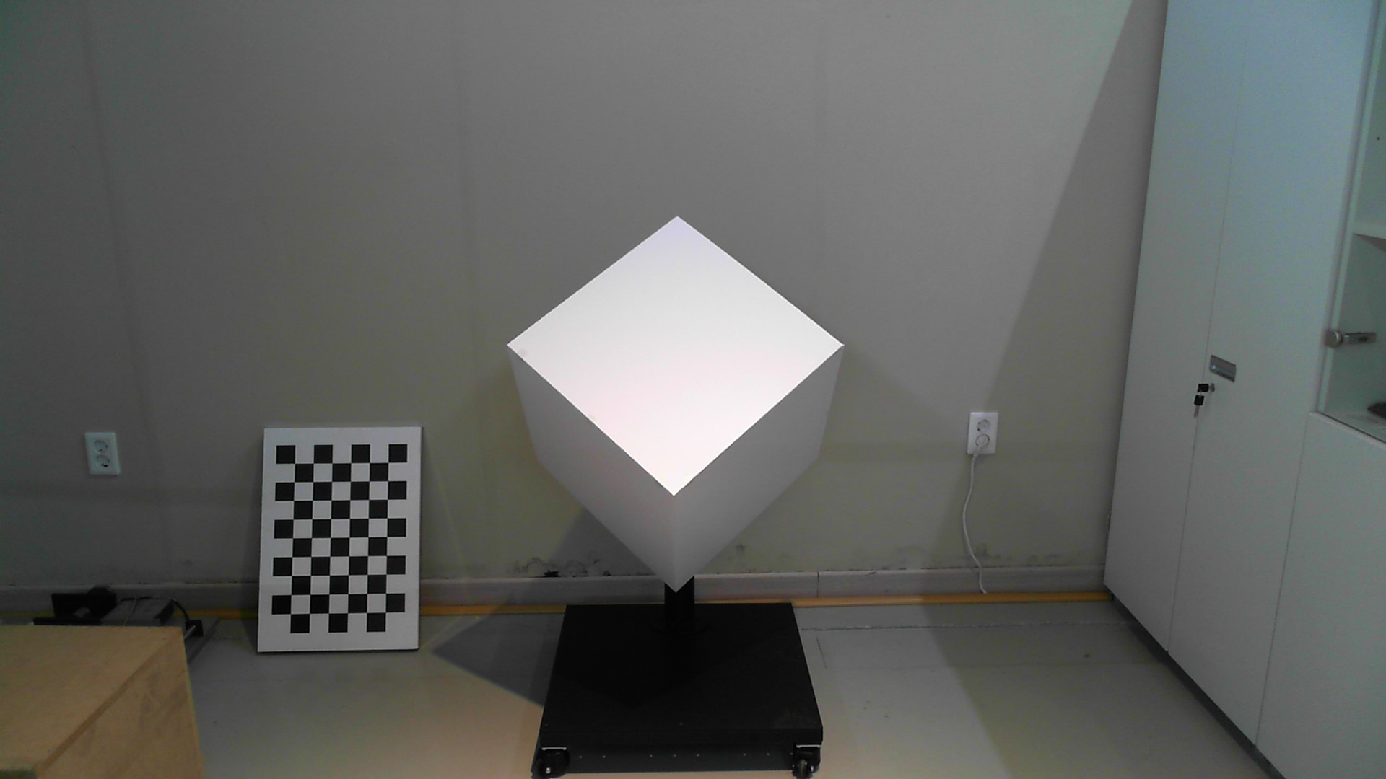
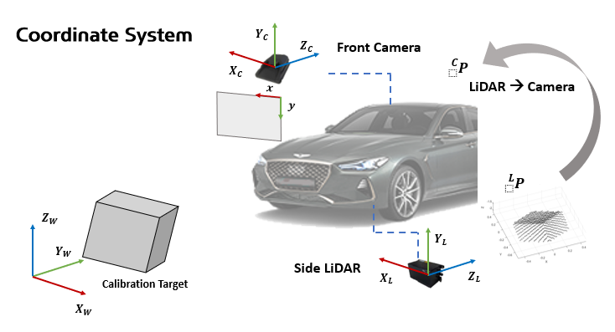
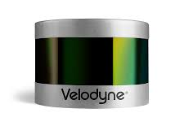
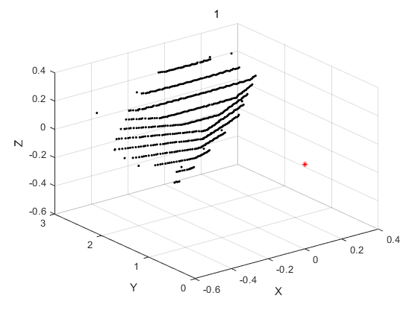
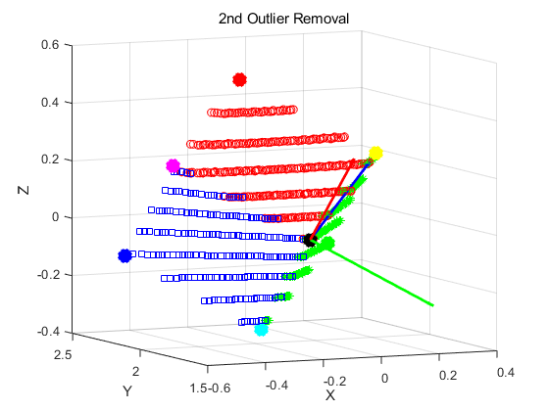
II. Process
Overview
MS 1080p HD
EPnP Algorithm
Velodyne VLP-16
Notes:
This part shows the whole overview for our study
We defined our coordinate system
and implemented calibration process as follow
------------------------------------------------------------
Firstly, we found seven feature points from each 3D and 2D data set
And then, we found transformation matrix using EPnP algorithm to obtain relative position between LiDAR and camera

Slide 7
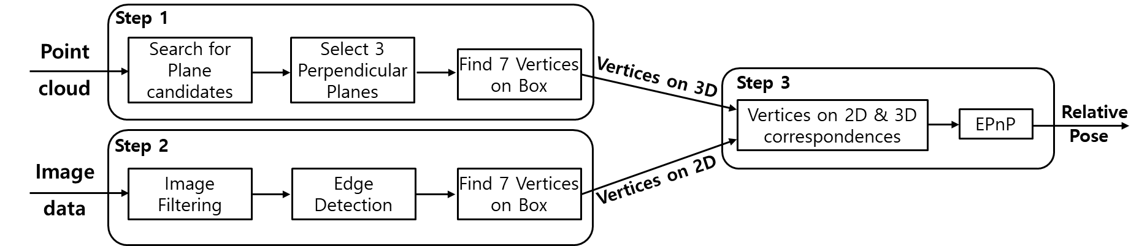
II. Process
Algorithm Flow Chart
Step 1 : Find 7 vertices from LiDAR point cloud.
Step 2 : Find 7 vertices from Camera image pixel.
Step 3 : Find transformation matrix using EPnP algorithm.
Notes:
This part shows about the whole process of our study (algorithm)
We firstly found seven feature points from each 3D and 2D data set
And then, we found transformation matrix using EPnP algorithm to obtain relative position between LiDAR and camera

Slide 8
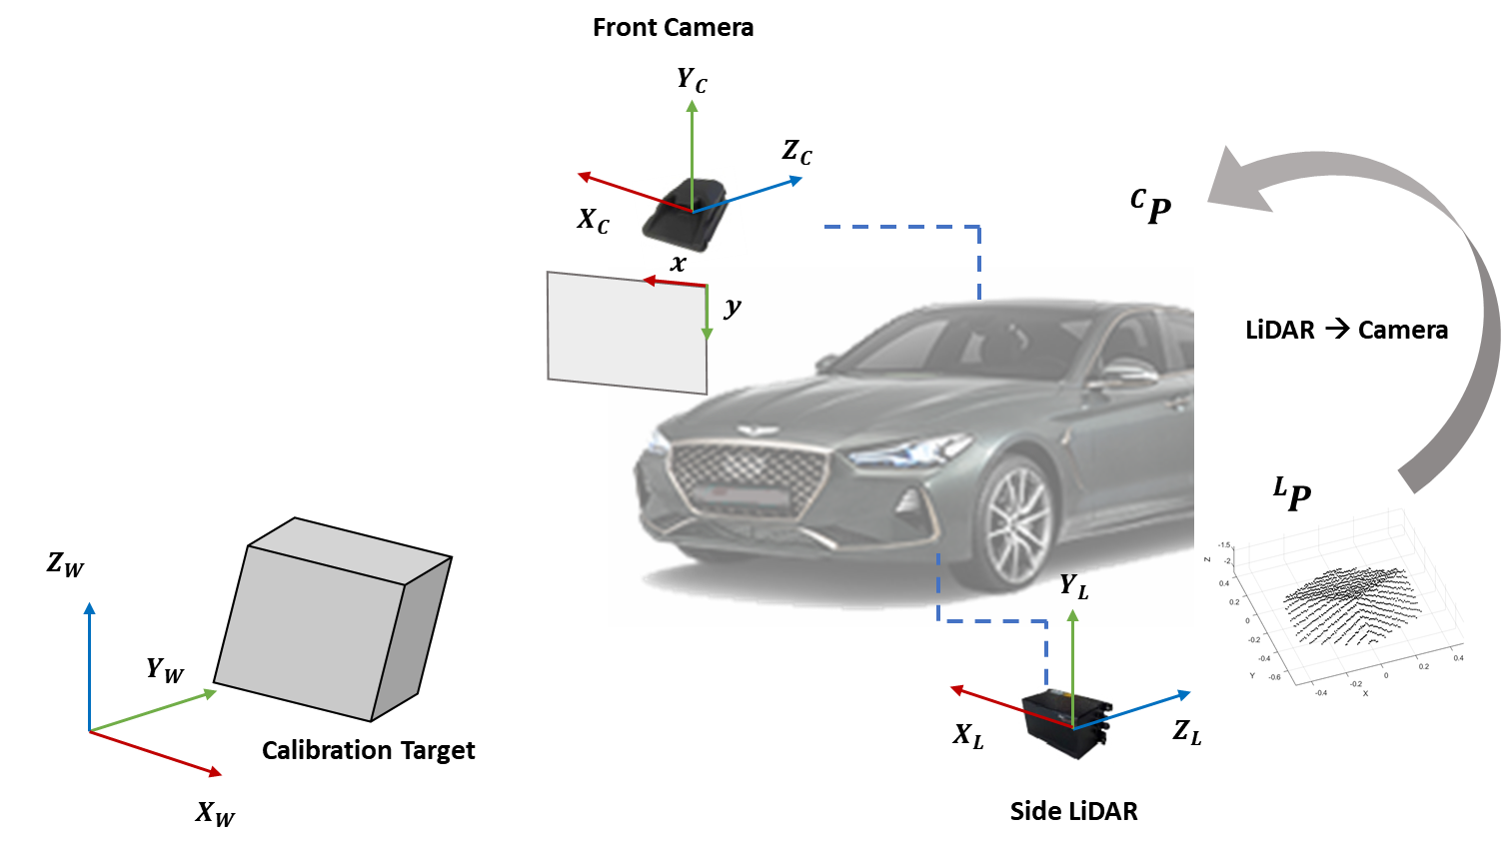
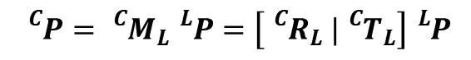
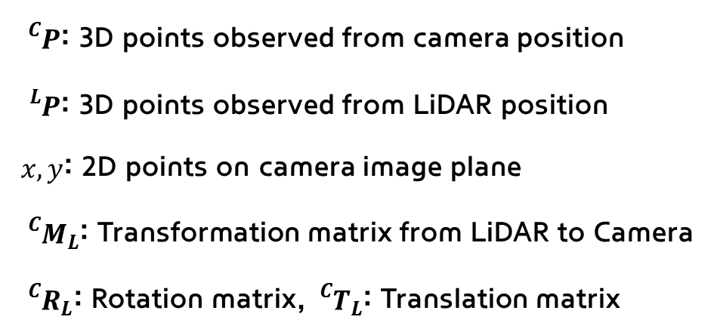
II. Process
Coordinate System
${}_{}^{C}P$: 3D points observed from camera position
${}_{}^{L}P$: 3D points observed from LiDAR position
$x,y$: 2D points on camera image plane
${}_{}^{C}{M_{L}}$: Transformation matrix from LiDAR to Camera
${}_{}^{C}{R_{L}}$: Rotation matrix, ${}_{}^{C}{T_{L}}$: Translation matrix
$${}_{}^{C}P={}_{}^{C}{M_{L}}{}_{}^{L}P=\left[{}_{}^{C}{R_{L}} |{}_{}^{C}{T_{L}}\right]{}_{}^{L}P$$
Notes:
Before explaining our whole process, I'll talk about how to define the coordinate system for calibration.
Variable P represents the 3D points and the upper subscript means a coordinate system of LiDAR or Camera.
And x, y states the 2D points from camera image plane
The transformation matrix M, consists of Rotation Matrix and Translation Matrix.

Slide 9
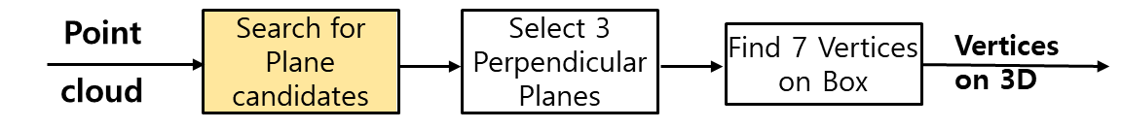
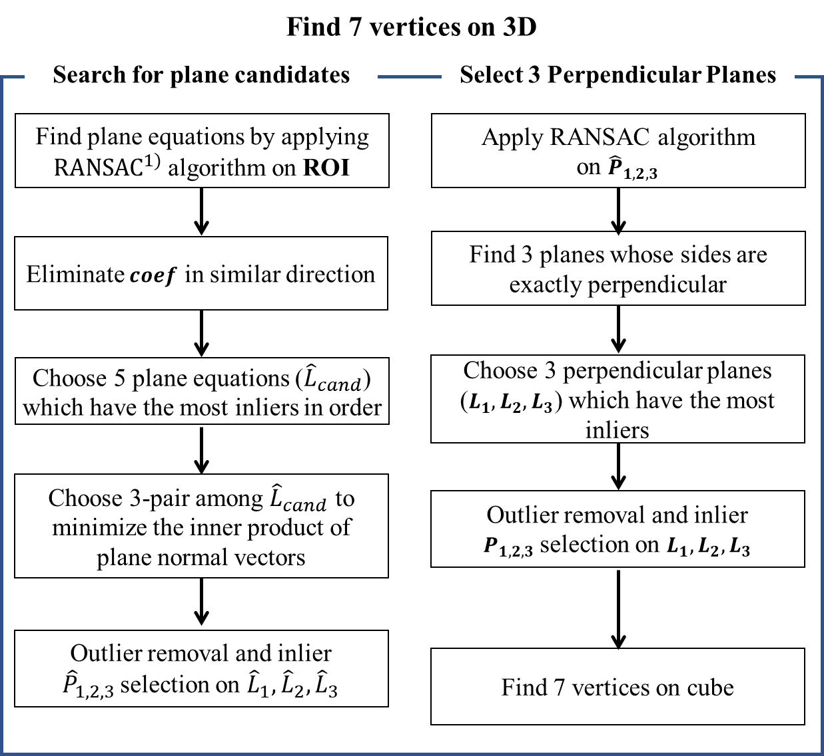
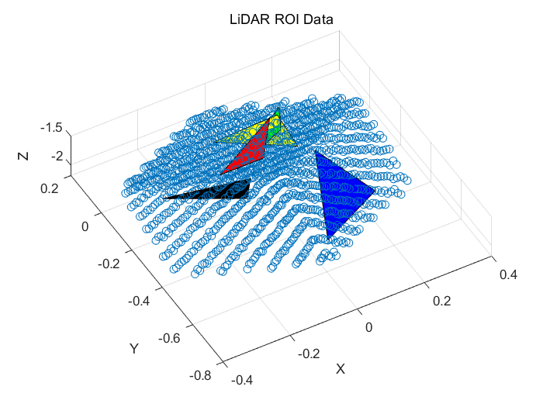
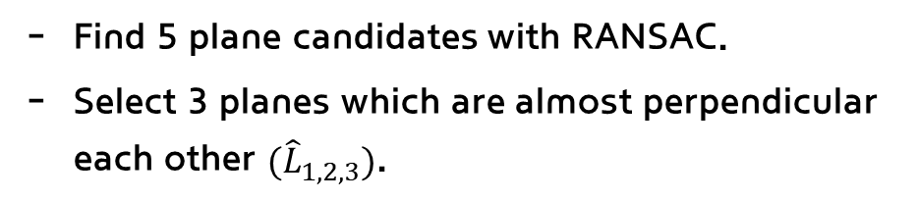
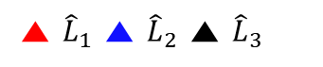
II. Process
Step 1
Find 5 plane candidates with RANSAC.
Select 3 planes which are almost perpendicular each other ${(\hat{L}}_{1,2,3})$.
▲ ${\hat{L}}_{1}$ ▲ ${\hat{L}}_{2}$ ▲ ${\hat{L}}_{3}$
<Plane Candidates>
1) RANSAC: Random Sample Consensus
Notes:
The first step is to find 5 plane candidates which have most inliers with ransac.
Ransac algorithm was used to choose three points randomly from our data set, for composing plane equations
And then, Among the 5 plane candidates, we selected 3planes which are almost perpendicular each other ${(\hat{L}}_{1,2,3})$..

Slide 10
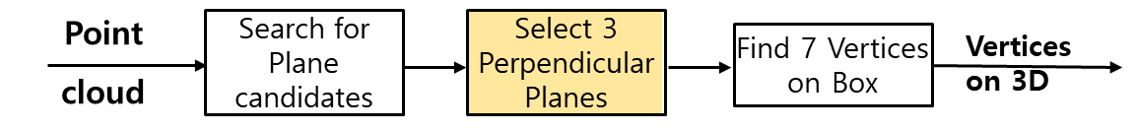
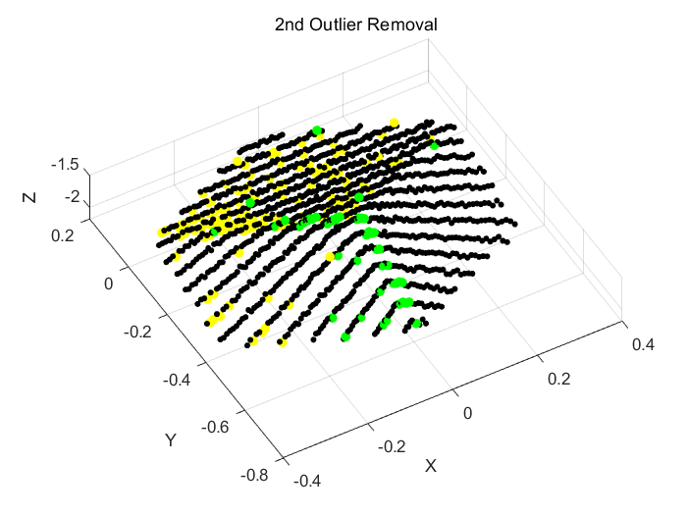
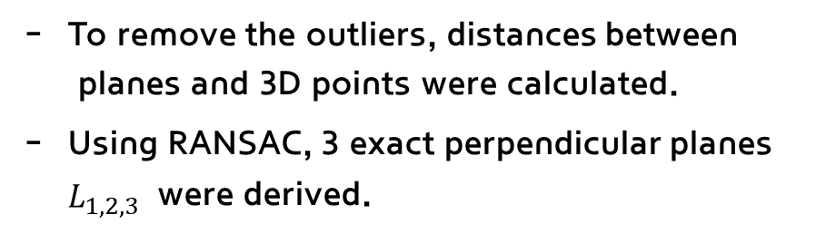
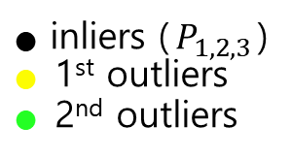
II. Process
Step 1
To remove the outliers, distances between planes and 3D points were calculated.
Using RANSAC, 3 exact perpendicular planes $L_{1,2,3}$ were derived.
● inliers ($P_{1,2,3}$)
● 1st outliers
● 2nd outliers
<Outlier Removal>
Notes:
To remove the outliers of our data for exact result,
we calculated the distance between planes and 3D points.
Repeating this process, we could get 3 exact perpendicular planes $L_{1,2,3}$

Slide 11
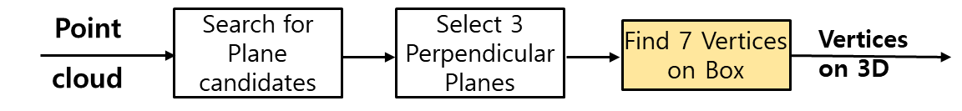
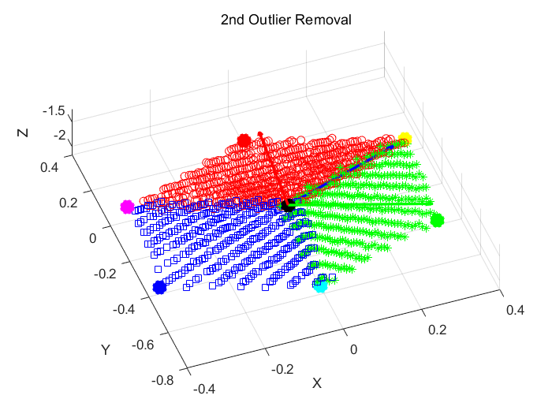

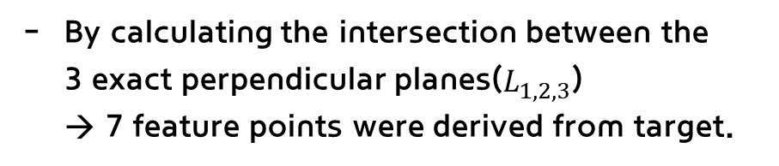
II. Process
Step 1
By calculating the intersection between the 3 exact perpendicular planes($L_{1,2,3}$) → 7 feature points were derived from target.
▲ $L_{1}$ ▲ $L_{2}$ ▲ $L_{3}$
1
6
2
7
5
4
3
<7 Feature Points>
Notes:
By calculating the intersection points between the 3 exact perpendicular planes,
We found the 7 feature points from cube target on 3D.

Slide 12
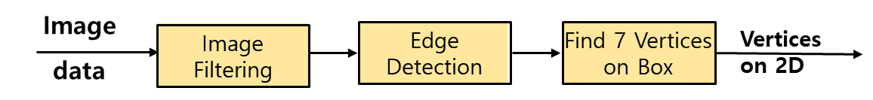
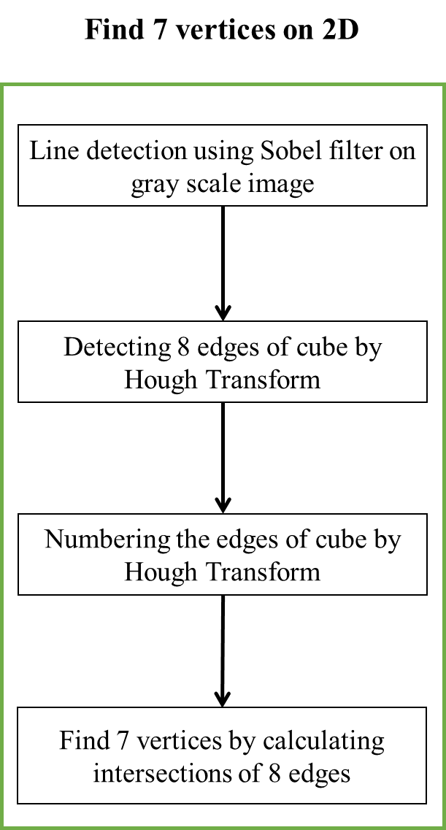
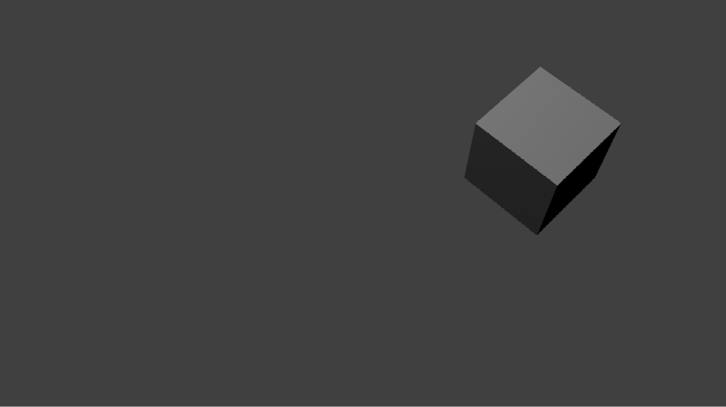
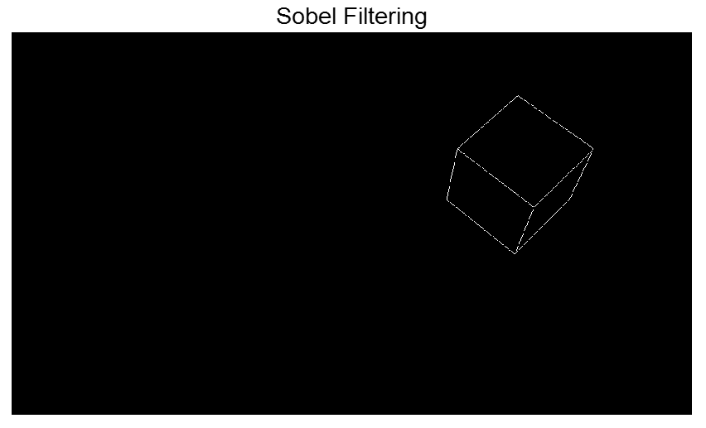

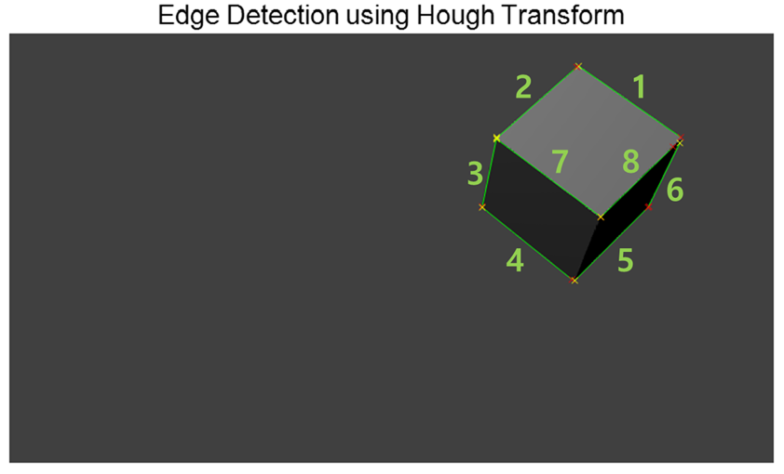
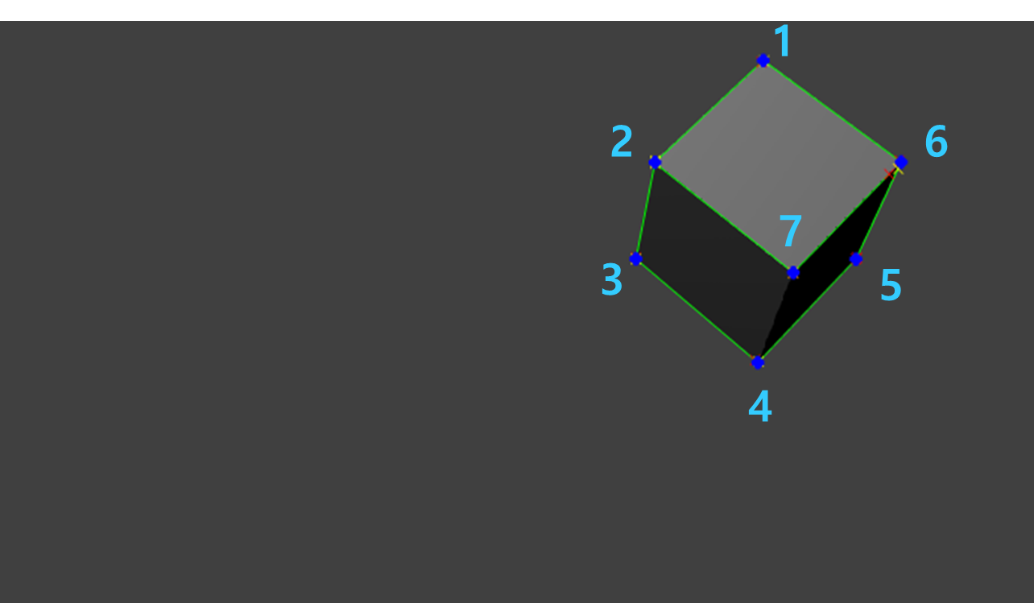
II. Process
Step 2
Using “Sobel Filter” and “Hough transformation”, 8 edges were detected
By calculating the intersection points of 8 edges, 7 feature points were derived on 2D image.
<Camera Image>
<Sobel Filtering>
<Edge Detection>
<Feature Points>
Notes:
Step 2,
Using “Sobel Filter” and “Hough transformation”, we detected 8 edges
and their coordinates on image plane.
By calculating the intersection points of 8 edges on image plane,
we found 7 feature points from the target on 2D.

Slide 13
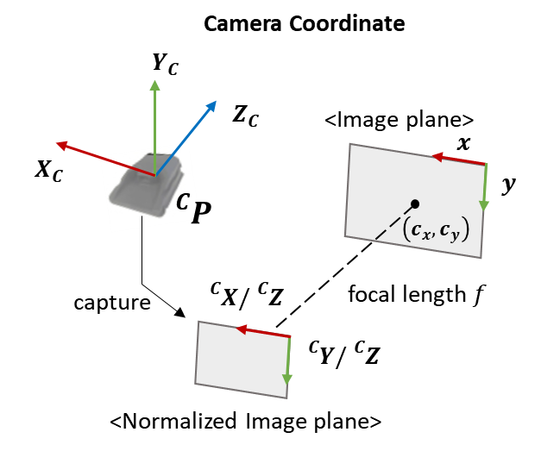
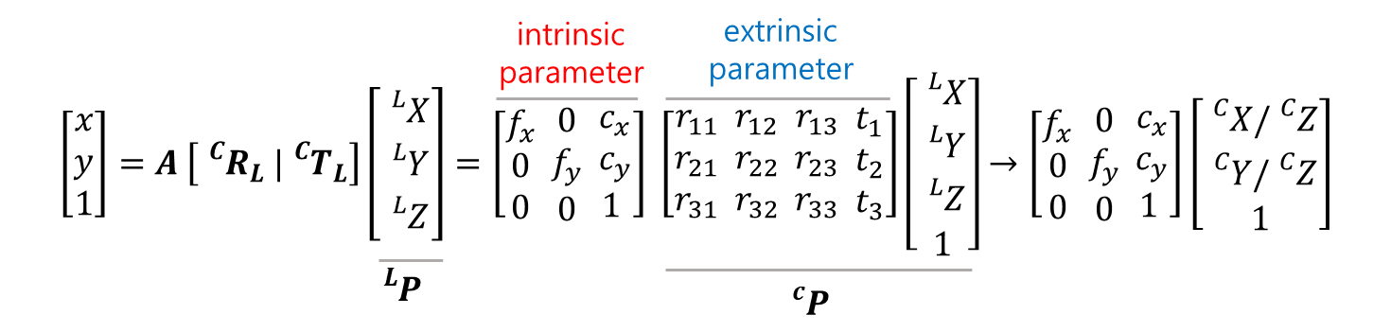
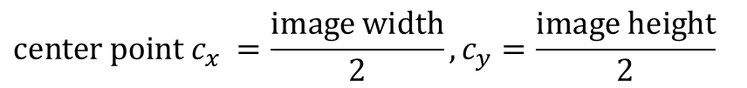
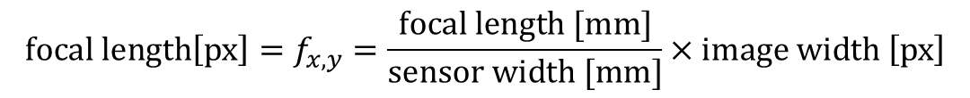
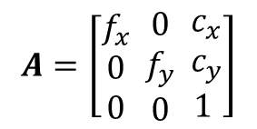
II. Process
Camera intrinsic parameter
The matrix A is used to map 3D points(${}_{}^{C}P$) on image plane.
$$A=\left[\begin{aligned}f_{x} \\ 0 \\ 0\end{aligned} \begin{aligned}0 \\ f_{y} \\ 0\end{aligned} \begin{aligned}c_{x} \\ c_{y} \\ 1 \end{aligned}\right]$$
$$focal length\left[px\right]=f_{x,y}=\frac{focal length [mm]}{sensor width [mm]}×image width \left[px\right]$$
$$center point c_{x} =\frac{image width}{2}, c_{y}=\frac{image height}{2}$$
Notes:
Before step 3, In order to map 3D points on image plane, we needed to know the intrinsic parameter of camera as following procedure
The parameters are composed of focal length and center point of image.

Slide 14
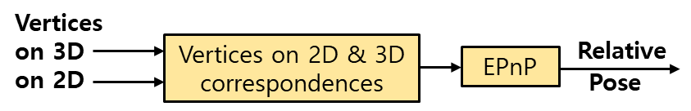
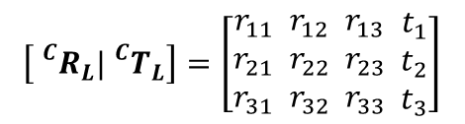
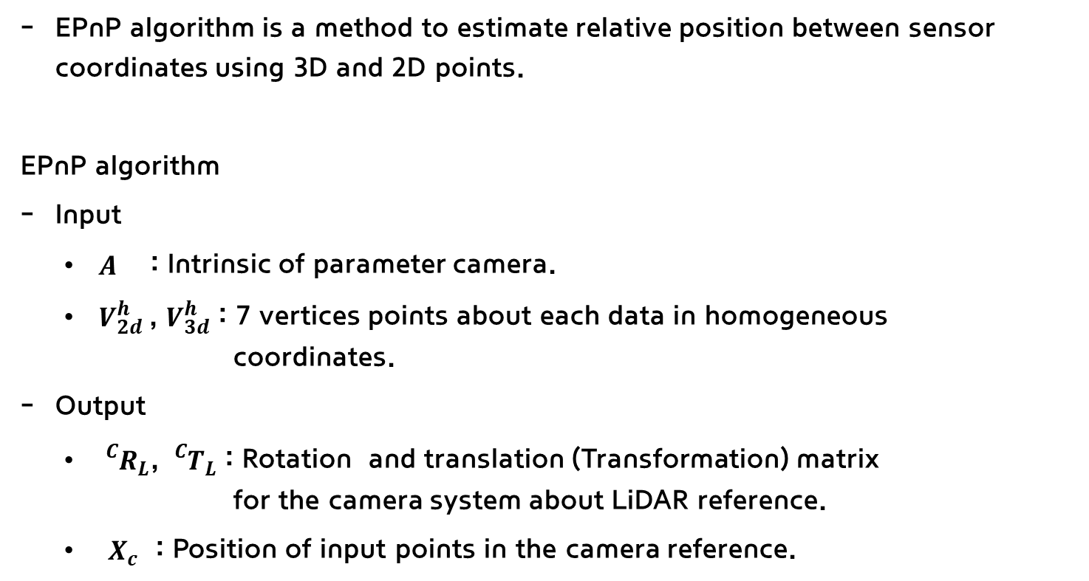
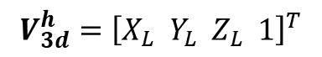
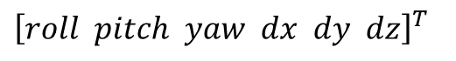
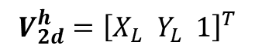
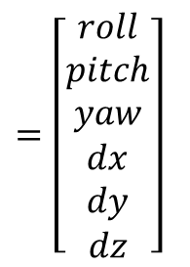
II. Process
Step 3
EPnP algorithm is a method to estimate relative position between sensor coordinates using 3D and 2D points.
EPnP algorithm
Input
$A$ : Intrinsic of parameter camera.
$V_{2d}^{h}$, $V_{3d}^{h}$ : 7 vertices points about each data in homogeneous coordinates.
Output
${}_{}^{C}{R_{L}}$, ${}_{}^{C}{T_{L}}$ : Rotation and translation (Transformation) matrix for the camera system about LiDAR reference.
$X_{c}$ : Position of input points in the camera reference.
Homogeneous Coordinate
$=\left[\begin{aligned}roll \\ pitch \\ yaw \\ dx \\ dy \\ dz\end{aligned}\right]$
$$V_{2d}^{h}={\left[X_{L} Y_{L} 1\right]}^{T}$$
Relative
Pose
$$V_{3d}^{h}={\left[X_{L} Y_{L} Z_{L} 1\right]}^{T}$$
Transformation Matrix
$$\left[{}_{}^{C}{R_{L}}|{}_{}^{C}{T_{L}}\right]=\left[\begin{aligned}r_{11} \\ r_{21} \\ r_{31}\end{aligned} \begin{aligned}r_{12} \\ r_{22} \\ r_{32}\end{aligned} \begin{aligned}r_{13} \\ r_{23} \\ r_{33}\end{aligned} \begin{aligned}t_{1} \\ t_{2} \\ t_{3}\end{aligned}\right]$$
Relative Pose
${\left[roll pitch yaw dx dy dz\right]}^{T}$
Notes:
Step 3,
EPnP algorithm is a method to estimate relative position between sensor coordinate
By using this algorithm, we derived transformation matrix and relative position between two sesnsors.

Slide 15
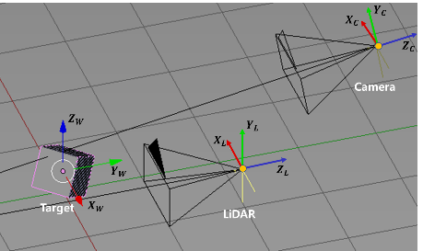

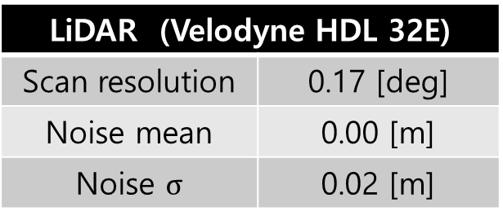
III. Simulation Result
Simulation setting
The virtual LiDAR 3D data and camera 2D data were obtained in “Blender” program
Target(cube) size is 0.5 x 0.5 x 0.5[m] and distance between target and LiDAR is 2[m]
Sensor Specification
LiDAR (Velodyne HDL 32E)
Scan resolution | 0.17 [deg]
Noise mean | 0.00 [m]
Noise $σ$ | 0.02 [m]
Camera (RGB)
Sensor size | 32 x 32 [mm]
Image size | 960 x 540 [px]
Focal Length | 35 [mm]
Notes:
Here is our simulation setting.
We used Blender program to obtain the virtual LiDAR and camera data set
And we set the configurations about each sensor as you can see

Slide 16
III. Simulation Result
Simulation result – Relative pose
Proposed calibration algorithm was applied to 10 data set about the same target.
Each of data set had 0.02[m] gaussian noise about depth.
The average relative position for the 10 data set was derived as follows.
Notes:
To validate our calibration algorithm, it was applied to 10 data set about same target.
Each of data set has 2cm gaussian noise about depth.
Therefore we calculated the average of relative position about 10 data
And you can see the results on the table
In this time, the maximum error of the simulation result was about 0.76[deg] and 0.06[m].

Slide 17






III. Simulation Result
Simulation result – Mapping data
LiDAR points were mapped on image plane with ${}_{}^{C}{M_{L}}$ derived from EPnP.
Proposed algorithm showed better result than other method.
mapping
<Result by proposed method>
<LiDAR 3D Point Cloud>
<Camera Image>
<Result by other method>
Notes:
We mapped LiDAR points on image plane with transformation matrix derived from EPnP algorithm.
As a result, proposed algorithm showed better result than other method.

Slide 18


IV. Experiment Result
Experiment Setting
The LiDAR 3D data and camera 2D image were obtained as in the simulation setting.
Target(cube) size is 0.5 x 0.5 x 0.5[m] and distance between target and LiDAR is 2[m]
MS 1080p HD
Velodyne VLP-16
<Camera Image>
Camera
LiDAR (Velodyne VLP-16)
VER./HORIZ. FOV | -15° ~ +15°/360°
Range Accuracy | ±3[cm]
VER./HORIZ. Angular Resolution | 0.1° / 0.4°
Cube Target
LiDAR
< LiDAR 3D Point>
Camera (RGB)
Image size | 1920x1080[px]
Focal Length | 1448[px]
Notes:
This is our experiment setting
We obtained real LiDAR and camera data as in the simulation setting.
And the specification for each sensor as follow

Slide 19




IV. Experiment Result
Algorithm Process for Experiment
The 7 vertices of cube target were derived from each data set.
LiDAR points were mapped on image plane to validate proposed algorithm on real data.
<LiDAR Point Cloud>
<Plane Candidates>
<Outlier Removal>
<Feature Points>
<3D Feature Points>
mapping
<Image Data>
<2D Feature Points>
<Feature Points>
<Edge Detection>
$$A=\left[\begin{aligned}1448 \\ 0 \\ 0\end{aligned} \begin{aligned}0 \\ 1450 \\ 0\end{aligned} \begin{aligned}960 \\ 540 \\ 1 \end{aligned}\right]$$
<Experiment Result>
Camera Intrinsic Parameter
Notes:
As a result, the 7 vertices were derived from each data set.
---------------------------------------------------
And then, we mapped LiDAR points on image plane to validate proposed algorithm on real data

Slide 20
V. Conclusion
Result and Discussion
A calibration system for LiDAR and camera was developed using 3D cube as calibration target.
Maximum error about calibration result has decreased compared to previous research.
Proposed algorithm will be applied to more channels of LiDAR (SOSLAB-SL1 40 channels)
Proposed calibration method can be used for mounting inspection of ADAS camera and LiDAR.
Proposed Algorithm | Rotation[deg] |  |  | Translation[m]
 | roll | pitch | yaw | dx | dy | dz
Ground Truth | 75.000 | 0.000 | 0.000 | 0.000 | 0.000 | 0.600
Estimation | 77.558 | -0.545 | 0.883 | 0.000 | -0.017 | 0.598
Error | 2.558 | 0.545 | 0.883 | 0.000 | 0.017 | 0.002
Previous Algorithm Error | 5.00 | 0.13 | 0.25 | 0.03 | 0.11 | 0.01
Notes:
Our conclusion is as follow
We developed a calibration system for LiDAR and camera using 3D cube as calibration target.
At later, we will apply our algorithm to another LiDAR which have more channels for mounting inspection of ADAS.

Slide 21
Thank you
Notes:
Thank you for listening my presentation

